Slide 3
Overcoming
Eph. 4:20-32

Slide 4
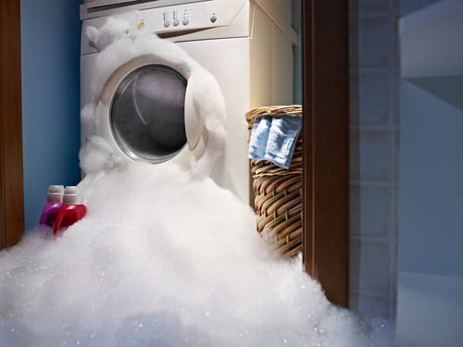

Slide 5
Overcoming
Eph. 4:20-32
The Jesus Way

Slide 6
Overcoming
Eph. 4:20-32

Slide 7
Anger
Overcoming
Eph. 4:20-32

Slide 8
Expectations
Anger
Overcoming
Eph. 4:20-32

Slide 9
Expectations
Offences
Anger
Overcoming
Eph. 4:20-32

Slide 10
Expectations
Offences
Anger
Resentment
Overcoming
Eph. 4:20-32

Slide 11
Expectations
Offences
Anger
Resentment
Bitterness
Overcoming
Eph. 4:20-32

Slide 12
Overcoming
Eph. 4:20-32
The Jesus Way

Slide 13
Overcoming
Eph. 4:20-32

Slide 14
Rewire your buttons – vv 22-25
Overcoming
Eph. 4:20-32

Slide 15
Rewire your buttons – vv 22-25
Keep it fresh – vv 26-27
Overcoming
Eph. 4:20-32

Slide 16
Rewire your buttons – vv 22-25
Keep it fresh – vv 26-27
Constant forgiveness – vv 31-32
Overcoming
Eph. 4:20-32

Slide 17
Rewire your buttons – vv 22-25
Keep it fresh – vv 26-27
Constant forgiveness – vv 31-32
Say double blessings – vv 28-30
Overcoming
Eph. 4:20-32

Slide 18
Overcoming
Eph. 4:20-32
The Jesus Way

Slide 19
Serious Stuff !!
The devil – v 27
The Holy Spirit – v 30
Overcoming
Eph. 4:20-32

Slide 20
Overcoming
Eph. 4:20-32
The Jesus Way

